Slide 1
Showwcase Analysis
Understand the user’s engagement of the platform

Slide 2
Research Topic
Goal
Question
Columns
Understand the users’ engagement of the platform
Examine different columns of the datasets to understand how
bugs_in_session
projects_added
session_projects_added
session_duration
comment_given
session_likes_given
inactive_duration

Slide 3
Bug in Session
Bug would be the biggest issue on customers’ experience

Slide 4
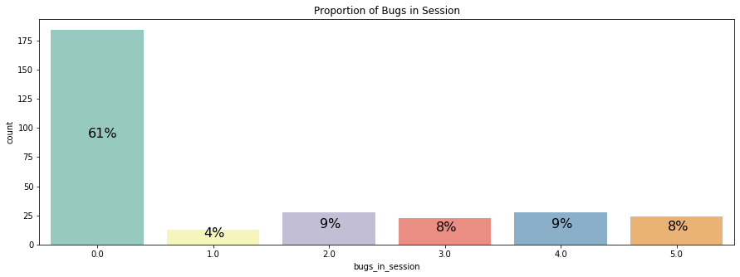
Proportion of Number of Bugs in Session
61% of session does not encounter any bugs
25% of sessions has 3 bugs or more in a session
Investigate the issue of bugs in order to minimize it

Slide 5
Project added During Session
Proportion of project added during session
Proportion of No of project added in session

Slide 6
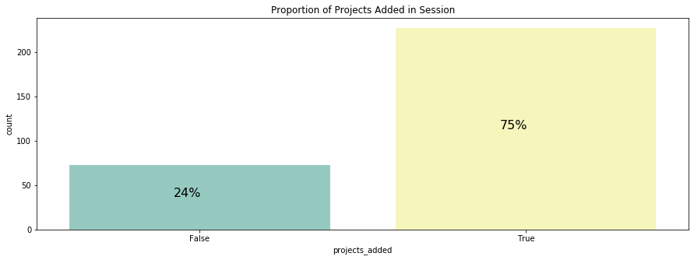
Proportion of project added during session
75% of sessions has project added
Most user will add projects while starting their session

Slide 7
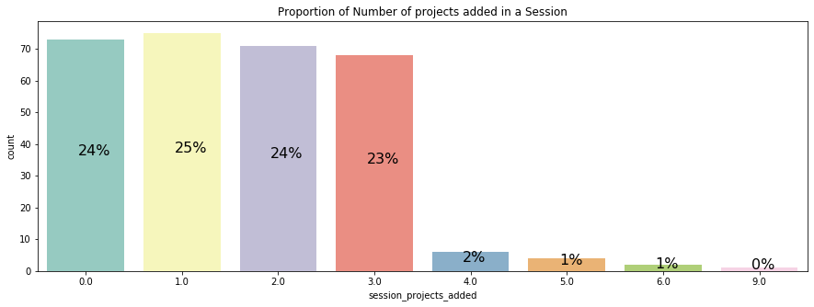
Proportion of Number of Projects Added in Session
25% of sessions have one project uploaded
96% of sessions has 3 or less than 3 projects

Slide 8
Session Duration
Mean : 1186 minutes
Median: 1152 minutes
Session Duration with and w/o comment given

Slide 9
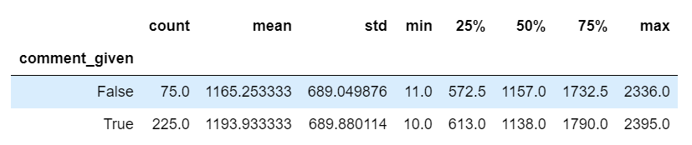
Session Duration with and w/o comment given
225 sessions with comment given
75 sessions w/o comment given
Mean of session Duration with comment : 1165.253 minutes
Mean of session Duration w/o comment : 1193.93 minutes
Median of session Duration with comment : 1138 minutes
Median of session Duration w/o comment : 1157 minutes
Most of the data are concentrated on the right of the mean
Basically, the duration of sessions tends to be higher

Slide 10
Likes Given
Examine the likes given of users
Discover the customer who get most like on their post

Slide 11
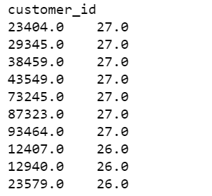
Top 10 users with most like
Suggestions:
Design rewards program for customer that can get most like within certain period
Encourage users to post more insightful contents
Engaged users with variable rewards

Slide 12
Inactive Duration
Mean : 732.9 minutes
Median: 313.5 minutes
Find out Users with most inactive duration

Slide 13
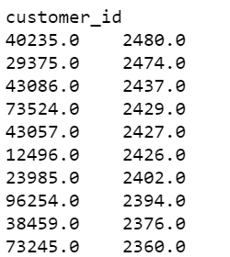
Top 10 users with most inactive duration
Suggestions:
Send personalized email to encourage them to ‘come back’
Show our new features to users
Remind users to ‘come back’
Collect feedback from those users to see what we can improve

Slide 14
~Thank you~

